Slide 1
Alamut

Slide 2
Hi!
Over the past 10+ years, I have gradually collected more than 540 plant species inventories in my floristic database, Alamut.
These inventories consist of plant species occurrence data extracted from published papers and research reports from the past three decades in Iran and neighboring countries.

Slide 3
How is this done, and how is it useful for diversity management and conservation? I am going to show you my simple approach in this video.
First, I developed a data structure and built a floristic database around it, refining both over time.

Slide 4
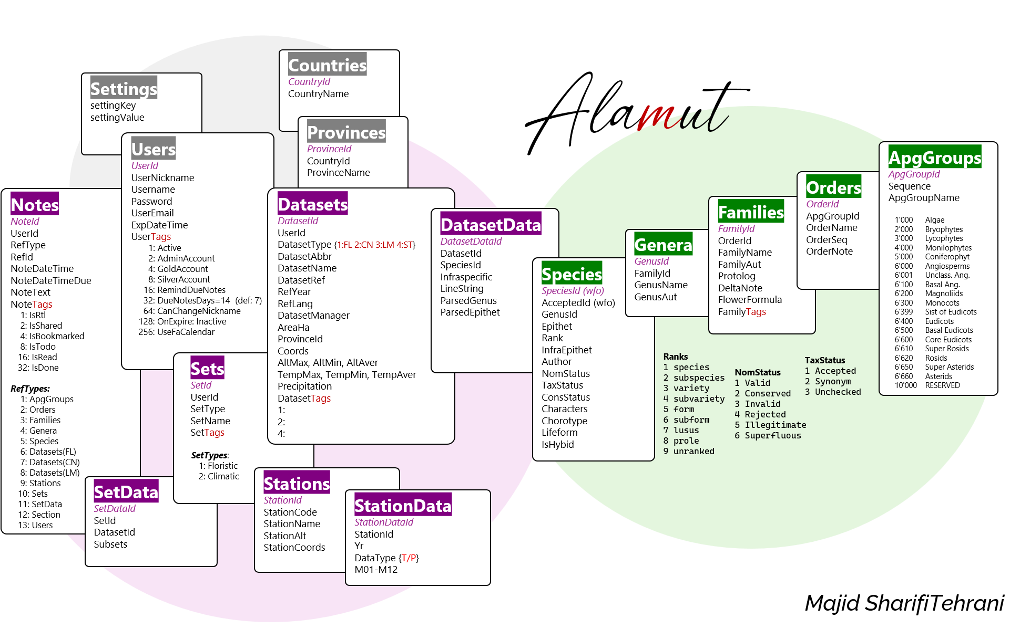
SQLServer

Slide 5
Then, I extracted raw lists of plant scientific names from the literature and prepared metadata for the geographic regions to which each list belongs.
Next, I corrected the lists for typos and other errors.
To do this, I developed a computer application named CheckName.
For literature not accessible as text, I reproduced the lists using another application called ListMaker.

Slide 6
The taxonomic backbone—comprising a complete list of world plant species from the World Flora Online (WFO)—is used in my database to accomplish these tasks.
In this video, I am going to show you how to create floristic datasets using Alamut database and its applications, ListMaker and CheckName.

Slide 7
I hope this web application will also help curators create their own datasets—either by using ListMaker (if they have not yet entered any data into a computer) or by using CheckName (if they already have a list and wish to correct it and encode it with standard WFO IDs).
If you are interested to know more, my next step is to provide analyses of the floristic datasets, including Shannon’s Diversity Index, the Floristic Value for each region, simple floristic analyses describing the percentage share of genera and families, as well as the top 10 dominant categories, and Multivariate analyses among others.

Slide 8
Alamut Blazor-server web app
Layers
Page < />
(HTML + C# + Blazor + MudBlazor)
Code { }
(.Net10 + C# + JavaScript:
Frontend Service
HttpClient
API
Controller
Interface
Backend Service
SqlClient
SqlServer
Tables
Scemas
Stored Procedured
HTML, Bootstrap, Javascript
.Net Core, C#

Slide 9
CheckName app in Alamut DB
parsing method
|Part A |Part B |Part C |Part D |Part E |
Gen|G.#(Sect)#spec#SpecAut#supspec.#ssp#sspAut#var.#var#varAut#subvar.#subvar#subvarAut#forma#forma#formaAut
| ^ ^ ^ | - ^ | - ^ | - ^ | - ^ |
Remove double spaces, double dots, complete missing chars
Consider variants and abstractings
Find landmarks and spaces
Parse complex lines into components
C#

Slide 10
Alamut
Diversity of Datasets
Using Alamut

Slide 11
Datasets
Dataset
Dataset
Dataset
Dataset
Dataset
Dataset
Dataset
Dataset

Slide 12
Datasets
Dataset
Set of datasets
Dataset
Dataset
Dataset
Dataset
Dataset
Dataset
Dataset
Dataset
Dataset
Dataset
Dataset

Slide 13
Datasets
Dataset
Set of datasets
Results
Dataset
Dataset
Dataset
Dataset
Dataset
Dataset
Dataset
Analysis
Dataset
Dataset
Dataset
Dataset

Slide 14
Example:
Diversity measures of
selected published Local Flora in:
UAE and Saudi Arabia

Slide 15
Alamut
Floristic Value
Of a Region

Slide 16
Example:
Calculate FV of a region
in southern Iran
where 3 local floras are studied
(species lists are available)

Slide 17
Alamut
Verifying Dataset-DATA
Using Alamut . OFF-LINE

Slide 18
Example:
Correct plant species list in:
Contribution to the flora of Asir, Saudi Arabia

Slide 19
Alamut
Create new Datasets
from published papers

Slide 20
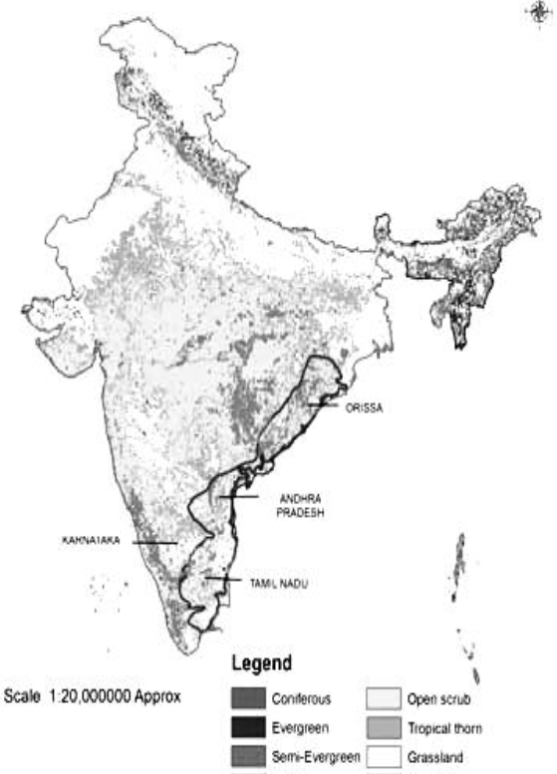
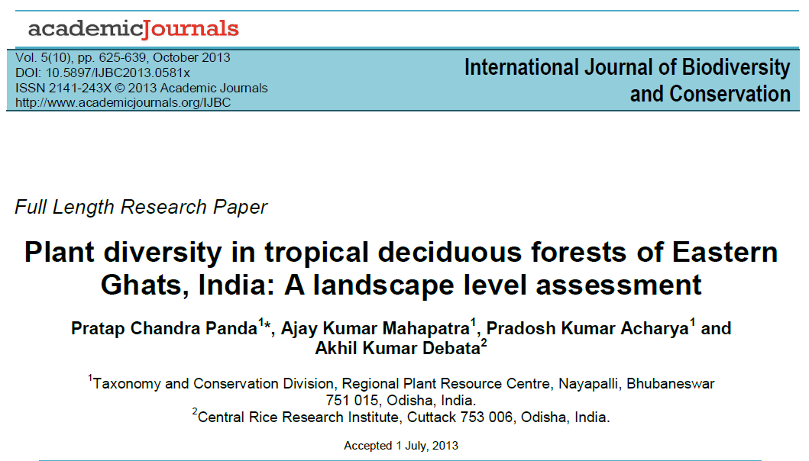
Example: List of Plant Species in tropical deciduous forests of Eastern Ghats, India

Slide 21
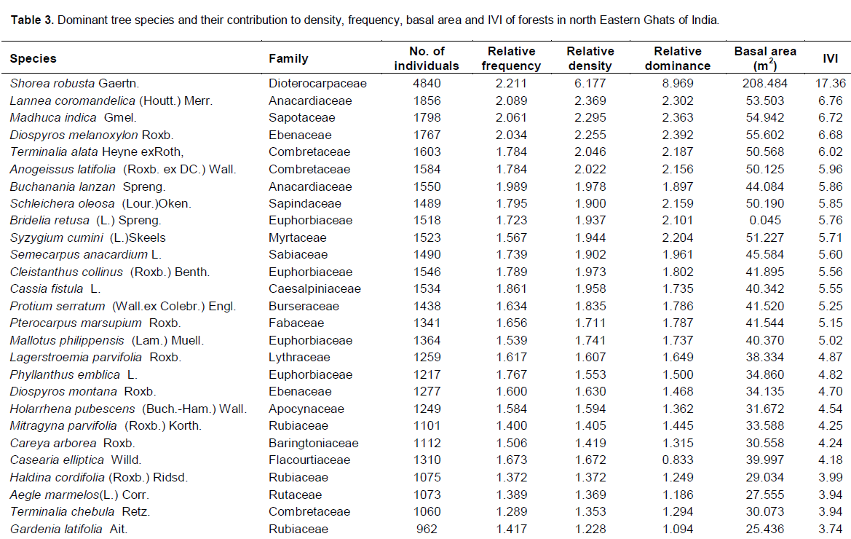

Slide 22
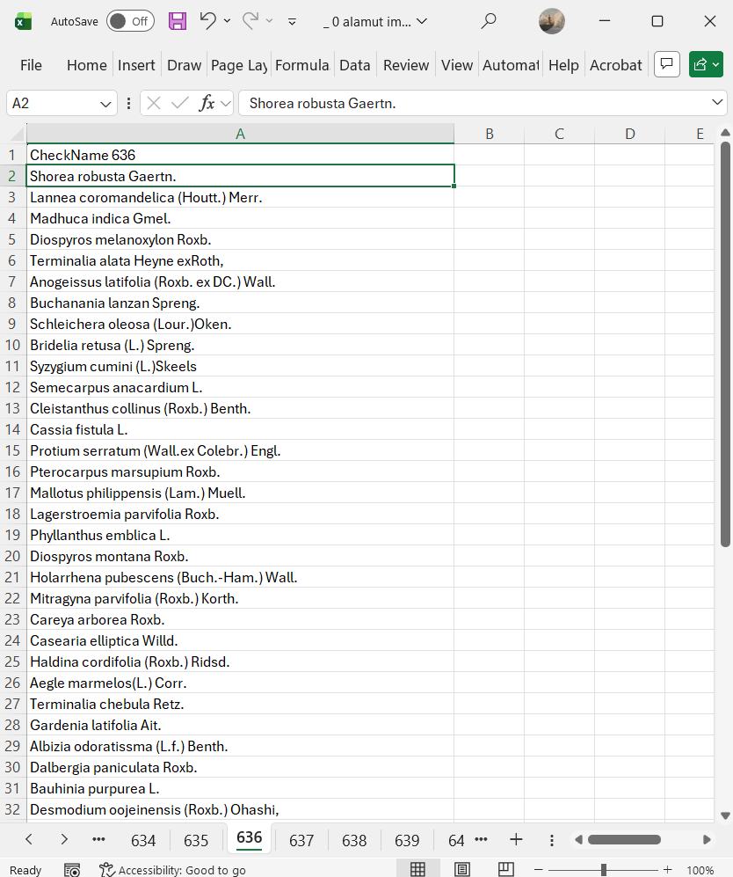
This is a small list of just 50 Plant species

